Slide 1
Introduction to Computer Network Project 4
Observe traceroute on opennet
Date: | 2016/12/22
Deadline: | 2017/01/02 (Mon.) 23:59

Slide 2
Outline
實驗目的
實驗環境
實驗流程
作業要求
本課程作業遲交扣分方式
Q&A

Slide 3
實驗目的
實驗目的
透過OpenNet模擬環境，實作與觀察TraceRoute運作
Notes:
學會如何使用Wireshark，和熟悉它內建的Filter功能
Wireshark是一個Open Source的產品，使用它能夠很方便擷取並觀察封包
熟悉這個工具對接下來的3個Project有很大的幫助

Slide 4
實驗環境
沿用Project 1-2環境
Ubuntu 14.04 LTS
OpenNet
建議使用1-2所提供的image
若要自己安裝/重灌OpenNet ,請 git reset --hard 3e8f44c
需自行安裝wireshark、traceroute

Slide 5
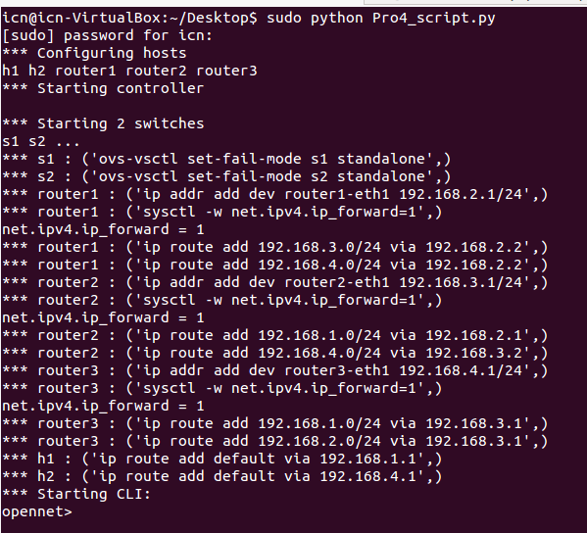
實驗流程(1/3)
在OpenNet中套用自定義拓譜Script
Sudo python your_script.py
Notes:
根據你的OS下載相對應的安裝檔

Slide 6
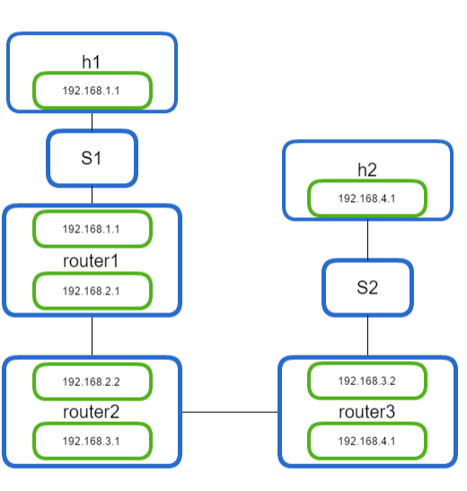
實驗流程(2/3)
拓樸圖

Slide 7

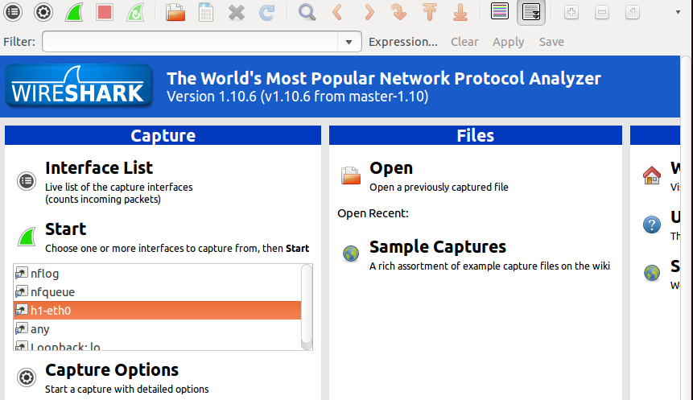
實驗流程(3/3)
執行traceroute:
opennet> h1 traceroute h2
在特定的Node上開啟wireshark:
Ex:抓取h1封包
opennet>xterm h1
在CLI開啟wireshark
選擇Interface

Slide 8
作業要求(1/2)
Briefly describe how traceroute works? (At least to answer what happened at host and each router.)
Observe a UDP packet (same Identification) at different interface on one router. (ex: router2-eth0 and router2-eth1) Explain why the IP header checksum is different.
Observe a packet (same Identification) at each router. Explain how the [ source , destination ] work at layer2 and layer3 and explain why they are different.
Hint: Filter={icmp || ip.addr==192.168.4.2}

Slide 9
作業要求(2/2)
Your report should include
Environment & Experiment steps (15%)
Text explanation with screenshot is acceptable.
Your comments (25%)
Comments with less than 50 words are not acceptable.
You can also describe problems you have encountered and solutions of those problems.
Please try to write something even if you did not encounter any problems.
The answer to the questions (60%)

Slide 10
作業要求
繳交方式
上傳到e3，檔名格式為：project4_學號.pdf
檔名或格式錯誤者，不予計分
Deadline: 2017/1/2 (Mon.) 23:59

Slide 11
本課程作業遲交扣分方式
遲交7日，Project 分數以原始分數九成計
超過7日，不再接受繳交，Project 以零分計

Slide 12
Q&A
如果對Project有任何問題
請來信 icnta@win.cs.nctu.edu.tw
計網概助教關心您

